Slide 1
B A T E C H N O L O G Y , D A T A , & I N S I G H T
Booking Completion Prediction :
Model Evaluation Summary
June 2 0 2 5

Slide 2
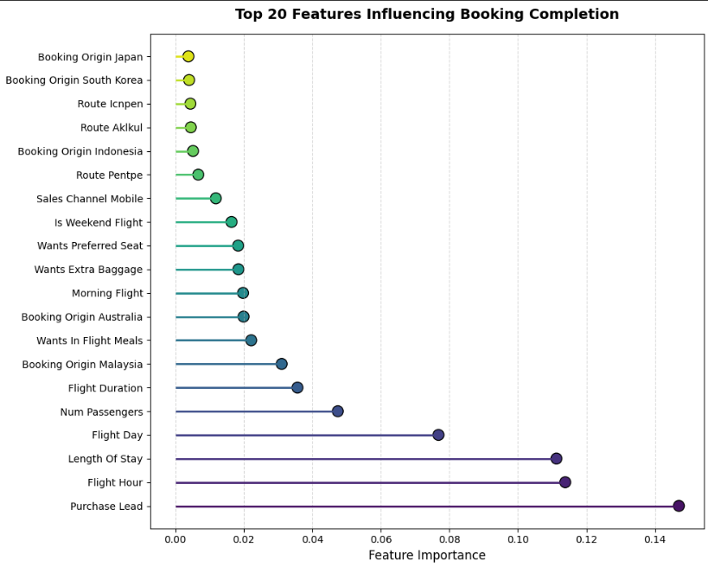
R E S U L T S:
Evaluation :
Purchase lead time, the number of days between booking and departure, emerged as the most influential predictor of booking completion.
Flight characteristics, including departure hour and flight duration, also contributed significantly to model predictions.
Customer demographic indicators, such as booking origin, had limited predictive power in the current model setup.
The model demonstrated a precision of ~0.70, meaning that when it predicts a booking will be completed, it's often correct.
However, a recall of ~0.003 indicates the model misses most true booking completions, suggesting the need for feature enhancement or alternative algorithms to improve sensitivity.
2

